Slide 1
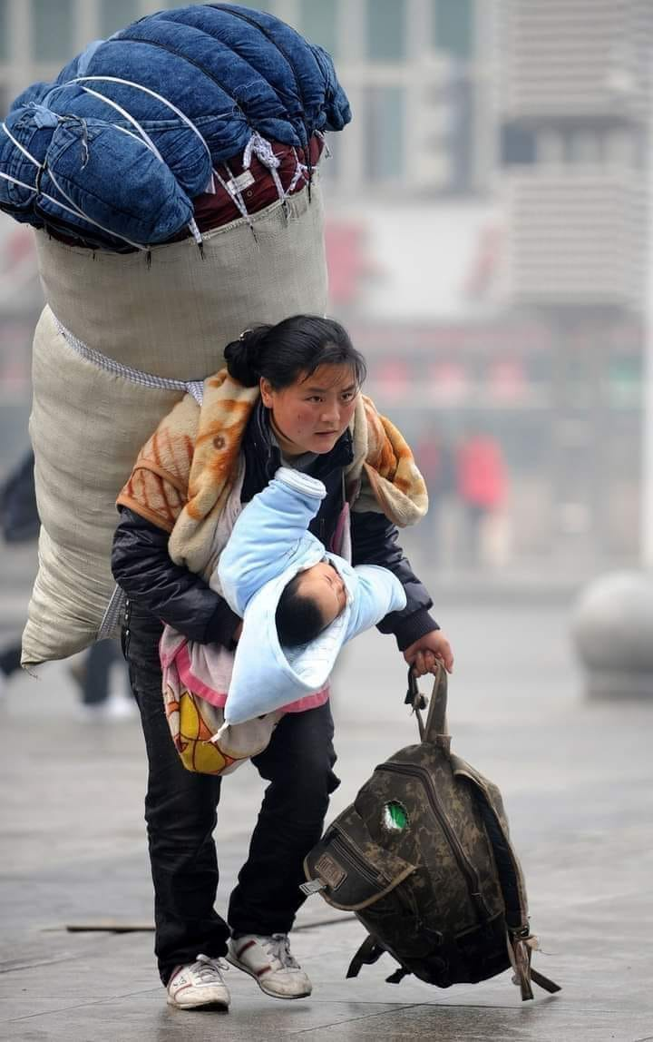
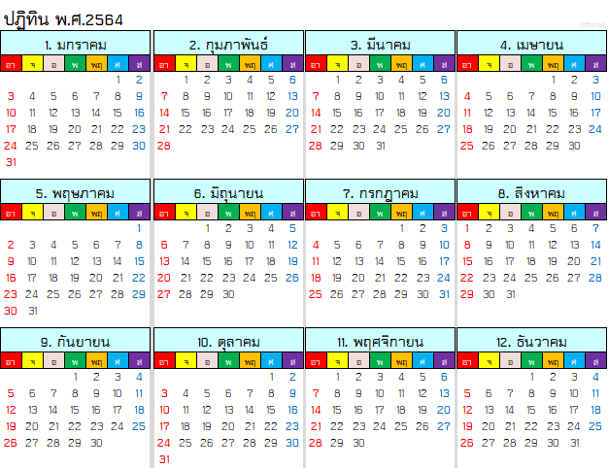
Bamu Yubumu
http://www.xinhuanet.com/english/2021-02/04/c_139721971.htm

Slide 2
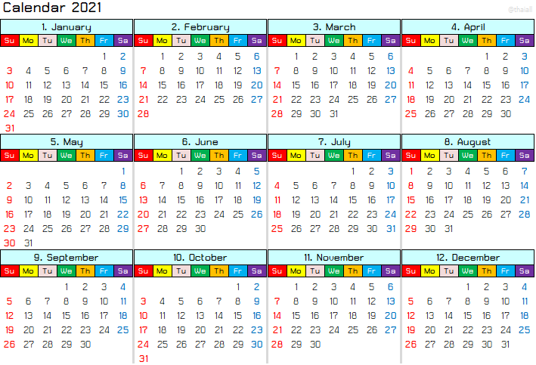
Bamu Yubumu
http://www.xinhuanet.com/english/2021-02/04/c_139721971.htm

