Slide 1
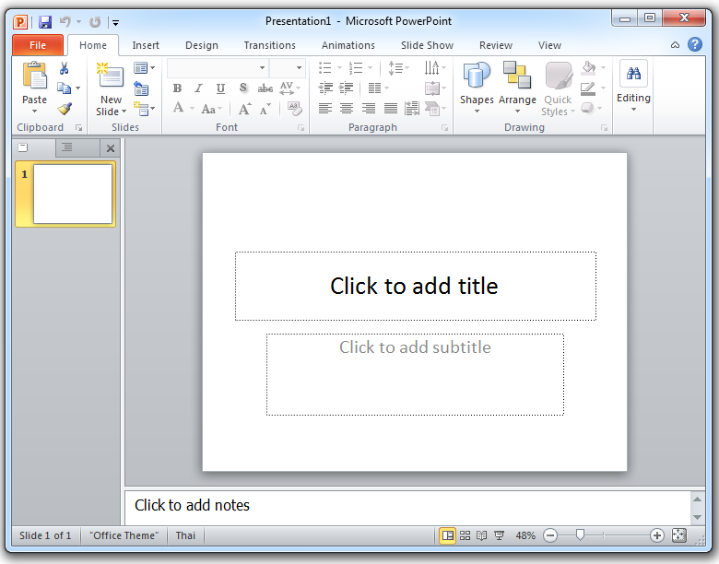
Microsoft Powerpoint Layout
1.Quick access toolbar
2. Title bar
3. Close button
5. Slide area
6. Ribbon menu bar
4. Slide tab
7. Note pane
9. Scroll bar
8. Status bar
10. Buttons view

Slide 2
Microsoft Powerpoint Layout
1. ___________________
2. _________
3. __________
5. _________
6. _____________
4. _______
7. _________
9. _________
8. ________
10. ___________

