Slide 1

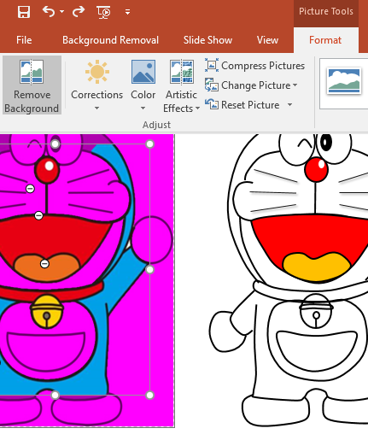
ปรับปรุง 20 ต.ค.2560
Microsoft Powerpoint 2007 to 2016
สามารถ remove background ได้

Slide 2

https://www.facebook.com/photo.php?fbid=10151807655591171&set=a.488877586170.294683.284423006170

Slide 3

Burin Rujjanapan
Sep 18,2013

Slide 4
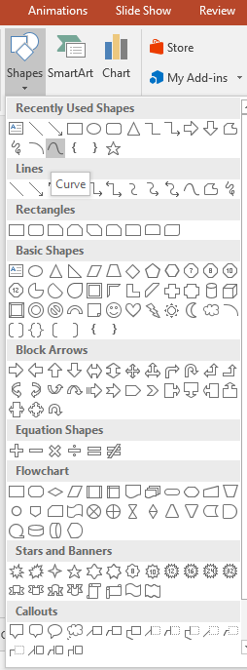
1. Insert, Shapes, Curve click, click, double click

Slide 5
2. Insert, Shapes, Curve click, click, click, (click),double click

Slide 6
3. Click, click, double click at start point

Slide 7
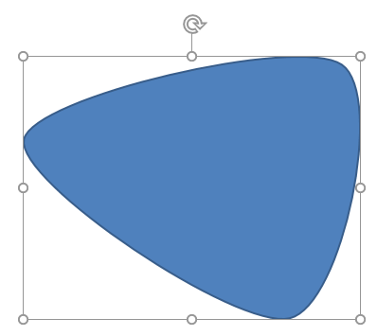
4. click on shape and rotate left or right and scale in or out and move

Slide 8
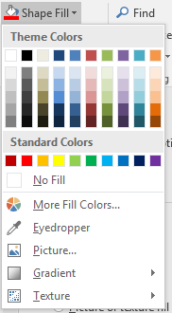
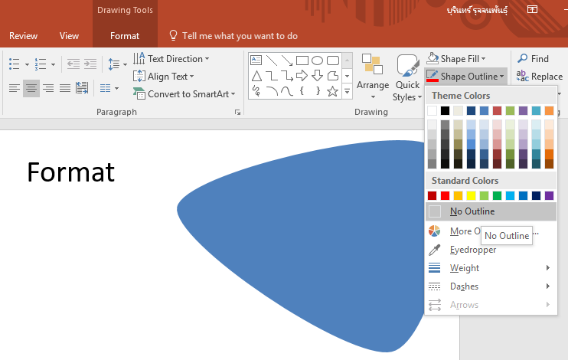
5. Format
Fill, Outline, Gradient
Picture

Slide 9
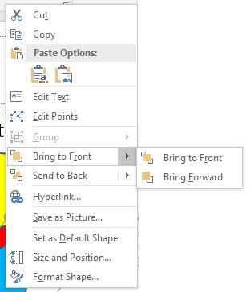
6. Right click on shape
Bring to Front, Send to Back

Slide 10
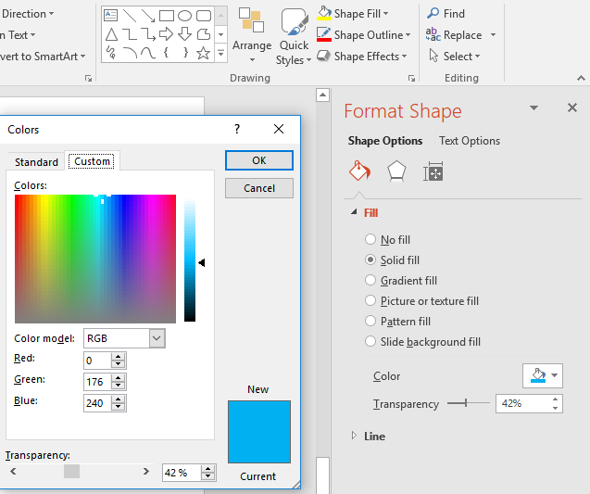
7. Shape Fill
More fill colors, Transparency

Slide 11
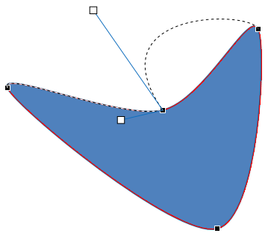
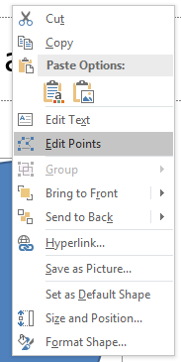
8. Right click on shape
Edit Point

Slide 12
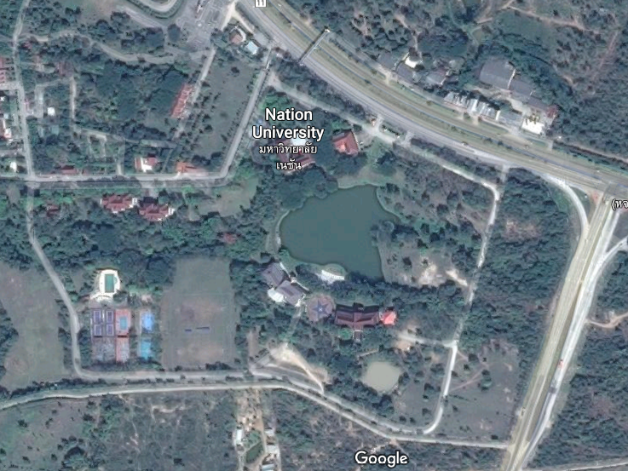
Nation University

Slide 13
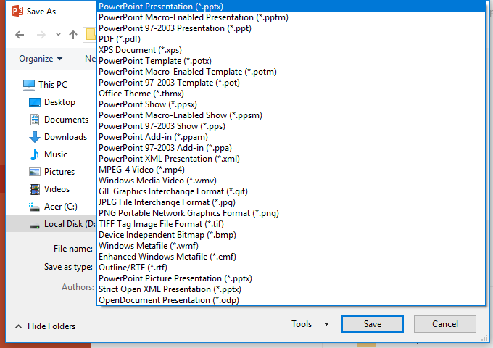
9. Save as JPEG or PNG

