Slide 1
Remove Background
By Powerpoint
Notes:
Updated july 31,2013

Slide 2
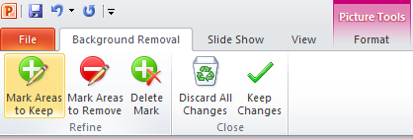
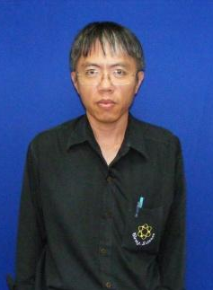
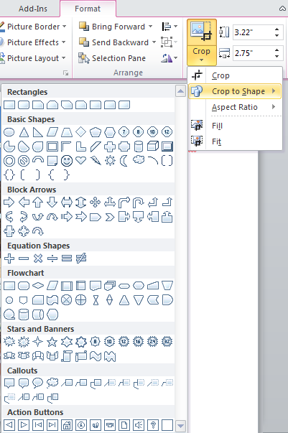
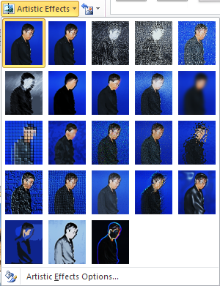
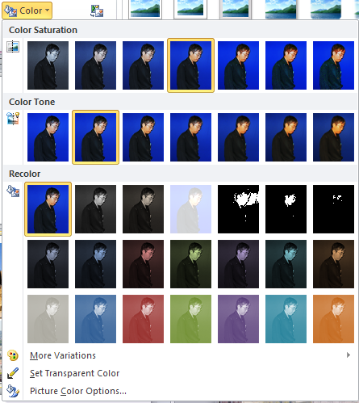
tools

Slide 3
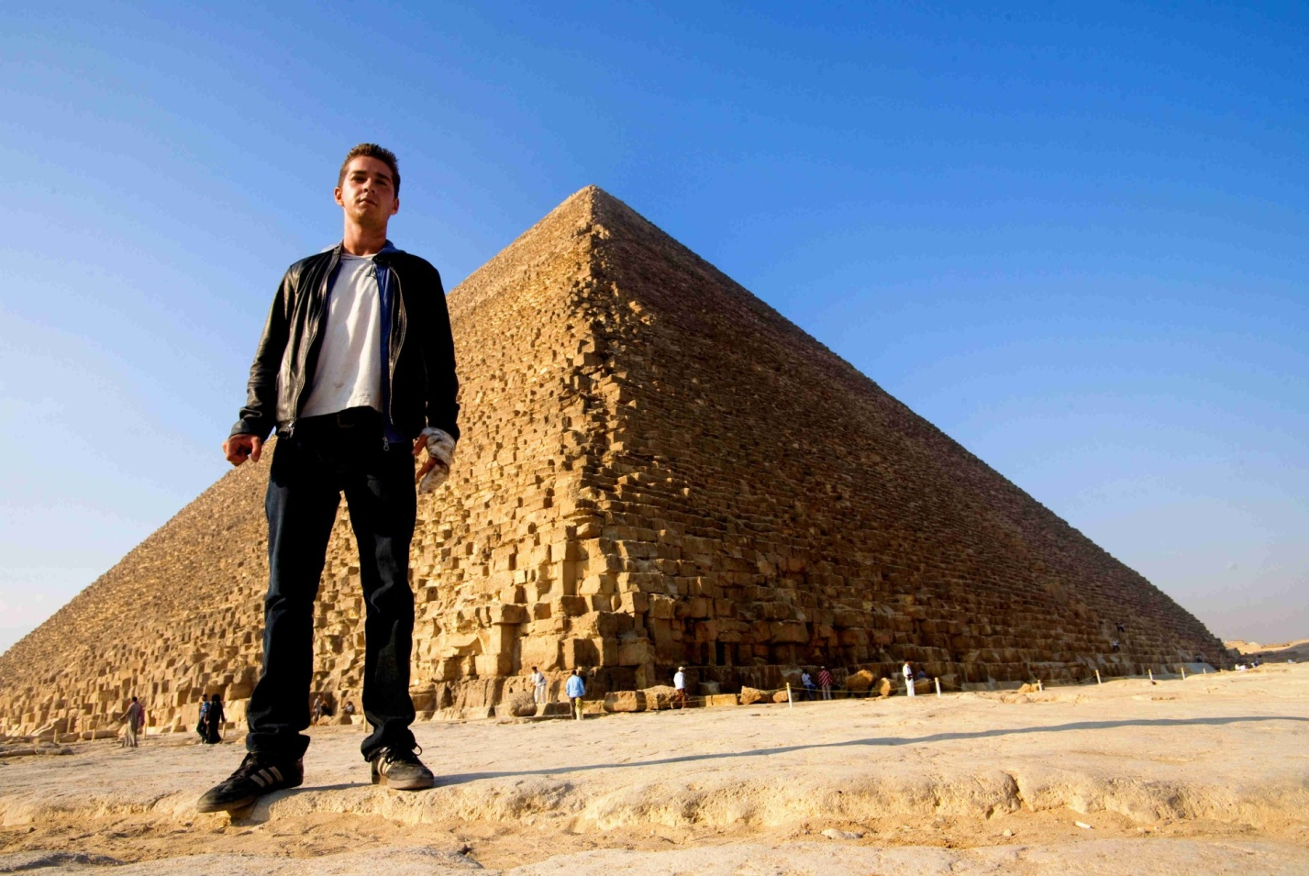
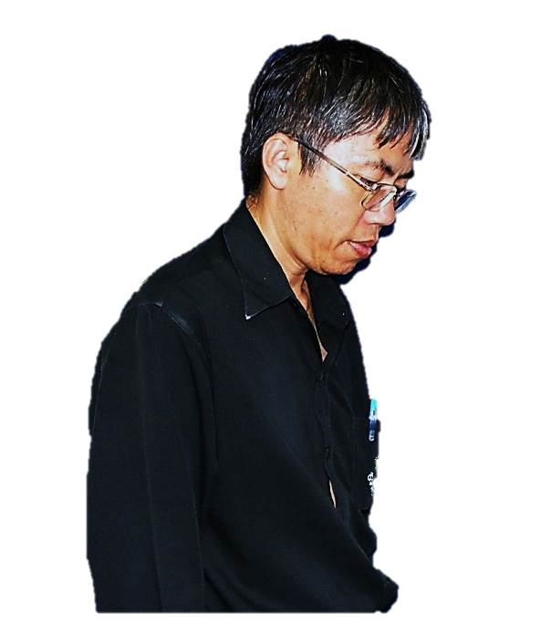
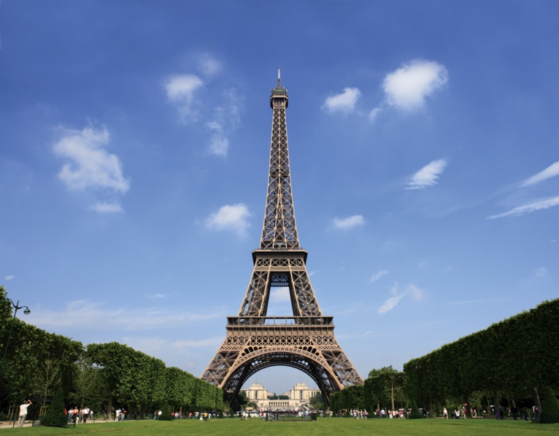
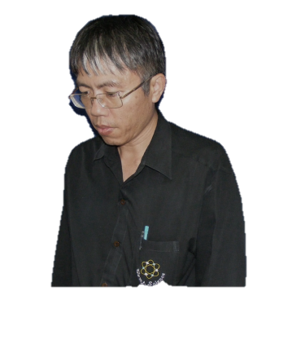
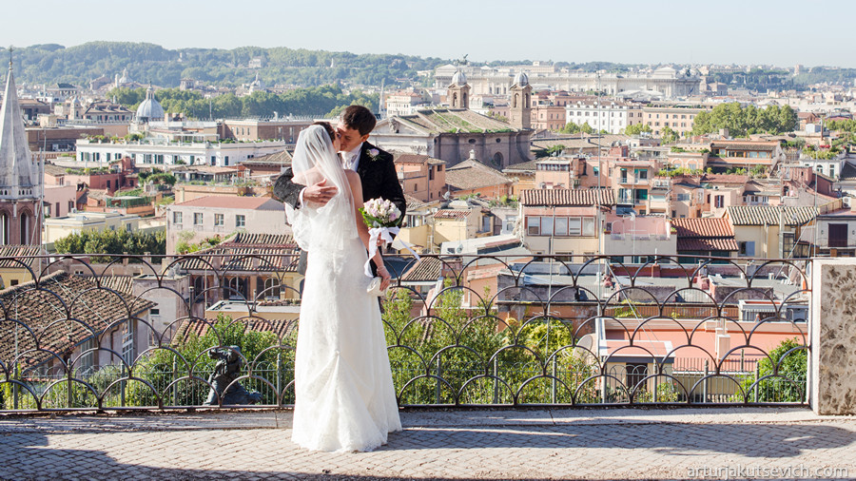
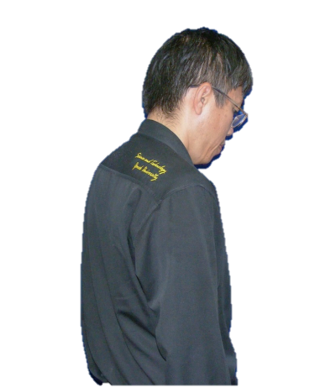
Retouch at
Paris, Pyramid, Rome by powerpoint 2010
Notes:
http://studentadventures.co.uk/static/uploads/large/1349104111.jpg
http://arturjakutsevich.com/wp-content/uploads/2013/01/wedding-in-rome.jpg
http://www.transformers2.net/wp-content/uploads/2009/06/transformers_2_shia_pyramid.jpg

Slide 4
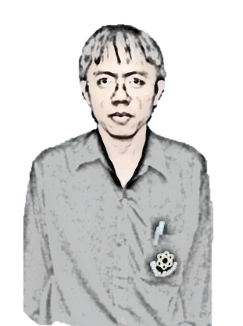
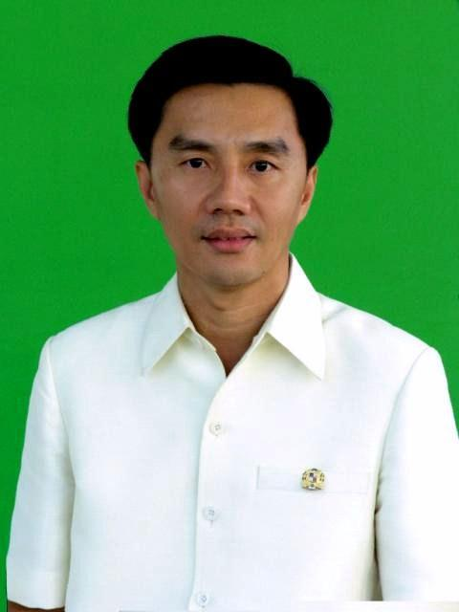


For practice
Remove background
http://km.camt.cmu.ac.th/PhD%20Photo/Forms/DispForm.aspx?ID=8

Slide 5
